Slide 1
ZERO SHOT SUPER RESOLUTION for microscopic images
Microscopic images enhancement using deep learning algorithm
Team members: Dor Elkabetz, Lior Baruchovitch, Tzlil Polyak
Mentor: Assaf Zaritsky

Slide 2
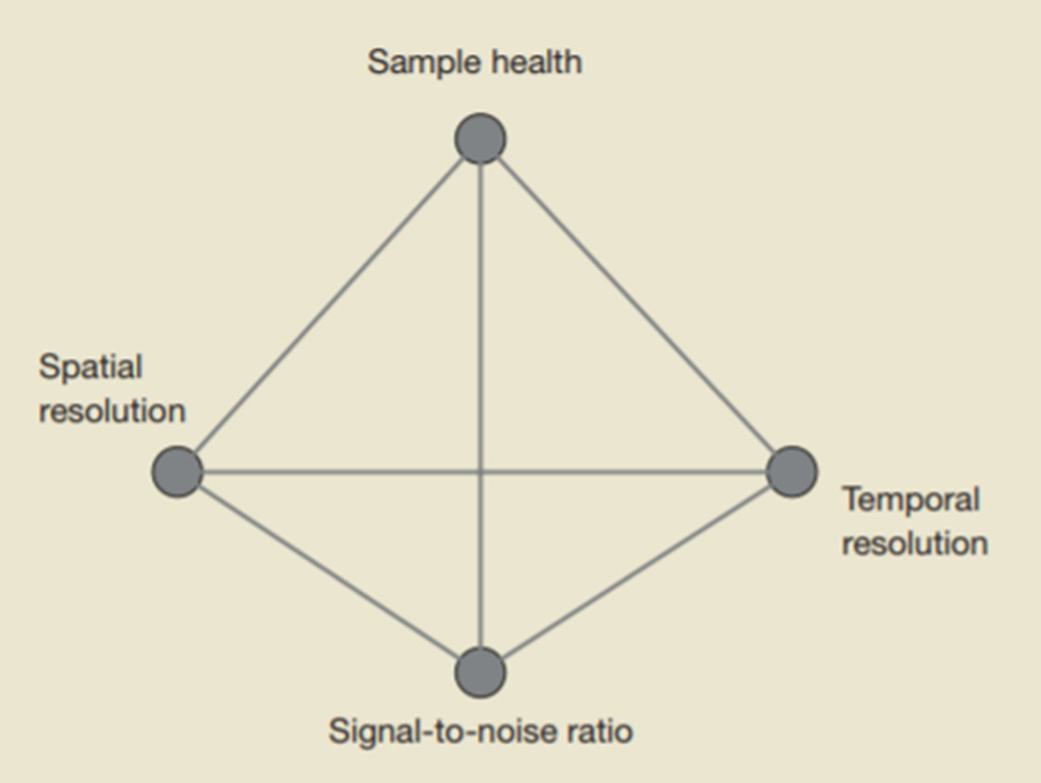
The Problem
The quality of microscopic images consists of tradeoffs between serval factors that every biologist should consider (such as the health of the sample versus the image resolution). Any researcher with an average performing microscope cannot mitigate these tradeoffs with the traditional equipment at his disposal.
These considerations are hurtful for any research that is using microscopic images!
A common problem for any biology lab all over the world.

Slide 3
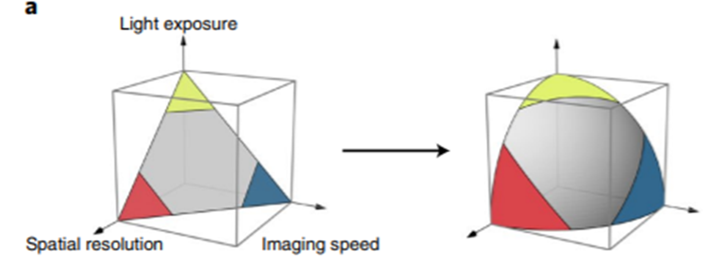
The Solution
Enhance images quality using deep learning algorithms!
Enables mitigating the tradeoffs with less compromise on image quality.

Slide 4
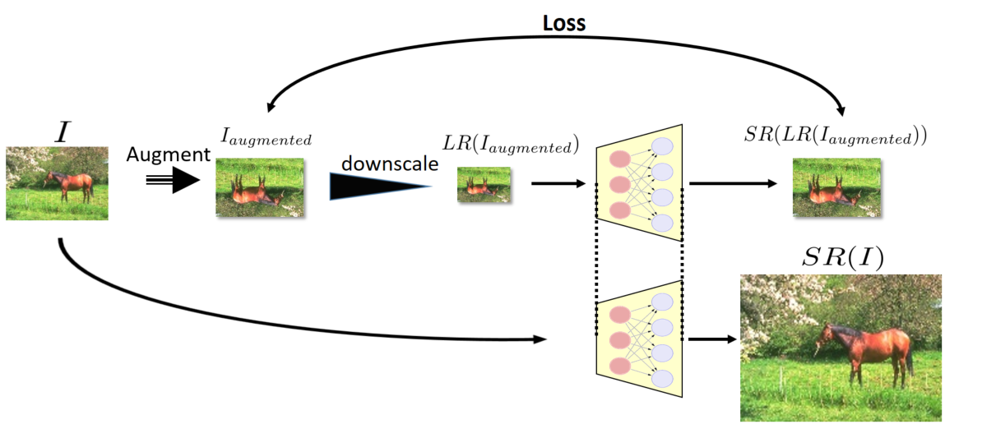
ZSSR
A deep learning image super resolution method developed by professor Michal Irani of the Weizmann Institute.
Partitioning the original image to augmented tiles
Training of the model on the created training set
Downscaling all of the tiles and the creation of a HR - LR pairs for the model training set
Upscaling the original image using the trained model

Slide 5
The Solution
Our goal is to prove that Zero Shot Super Resolution (ZSSR) is a viable deep learning algorithm for enhancing microscopic images that can be useful for biologists.

Slide 6
The Difference
While other methods for super resolution in microscopy require a large and expensive datasets of high resolution images to train a model on, ZSSR requires only the target image!
Cuts the costs and time for researches with limited resources.

Slide 7
How did we fit ZSSR for microscopic images
microscopic images have a unique “noise” not shared with regular pictures.
ZSSR needs to be adjusted using the unique downscaling kernel of the image we’re trying to improve.

Slide 8
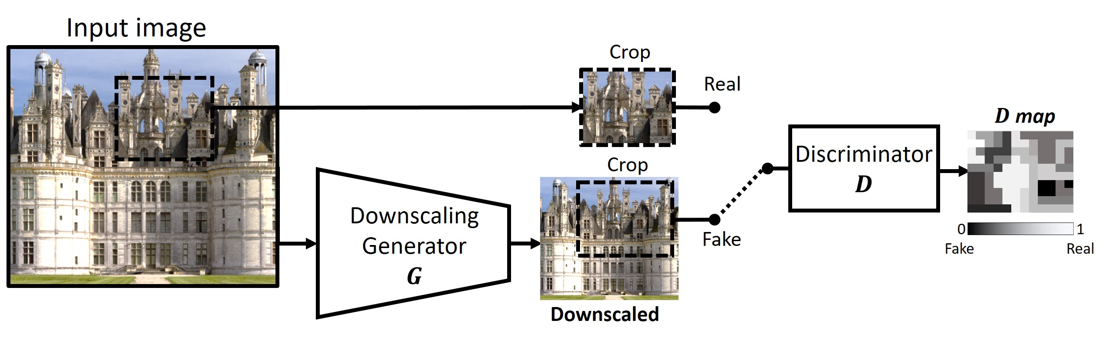
How did we fit ZSSR for microscopic images
To estimate the downscaling kernel we use prof. Michal Irani’s Blind Super-Resolution Kernel Estimation algorithm (A separate algorithm from ZSSR)

Slide 9

How did we fit ZSSR for microscopic images
We use the estimated kernel in the downscaling phase of the algorithm
Kernel

Slide 10
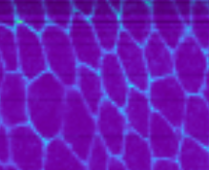
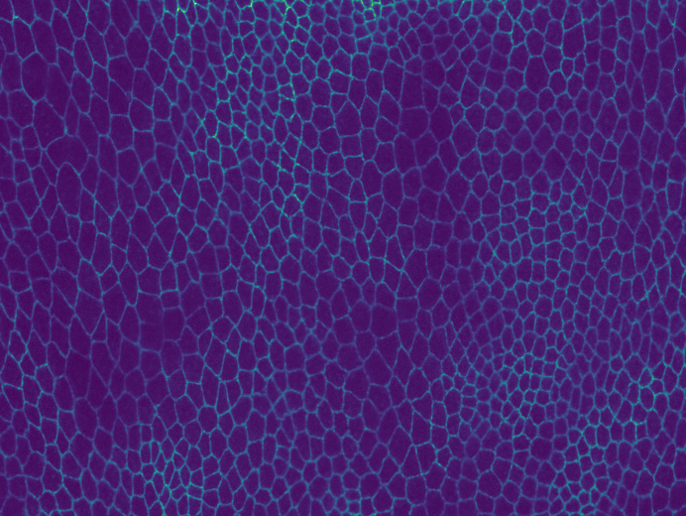
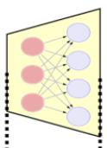
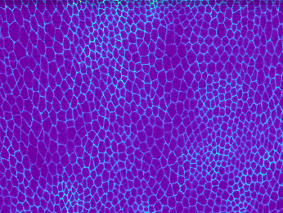
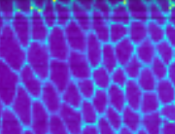
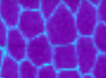
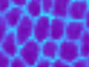
The process
ZSSR trains a model based on the generated training set
Training set
ZSSR generates a training set out of the downgraded image
Ground Truth
Downgraded
Downgrading using “CARE” simulator

Slide 11

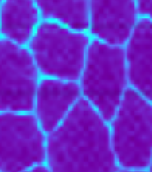
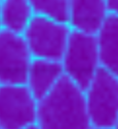
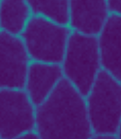
The process
Prediction
Downgraded
Ground Truth
Compare
ZSSR upscales the downgraded image using the trained model

Slide 12
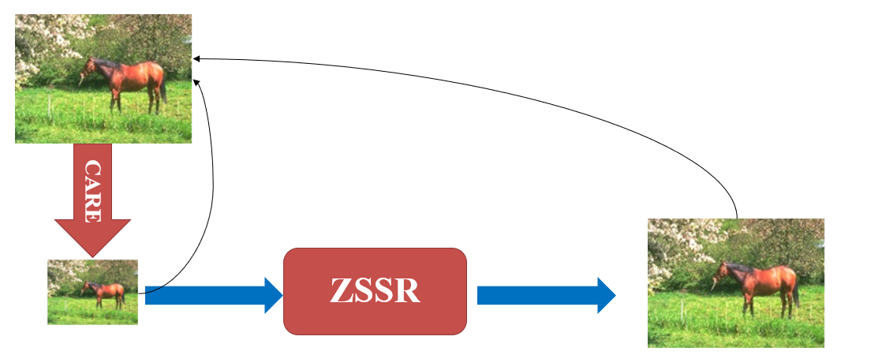
How did we evaluate performances
Comparing the results before and after using ZSSR relative to the ground truth image
Downgrading the original image using a microscopic downgrade simulator from the article “CARE”
Upscaling the downgraded image using ZSSR

Slide 13
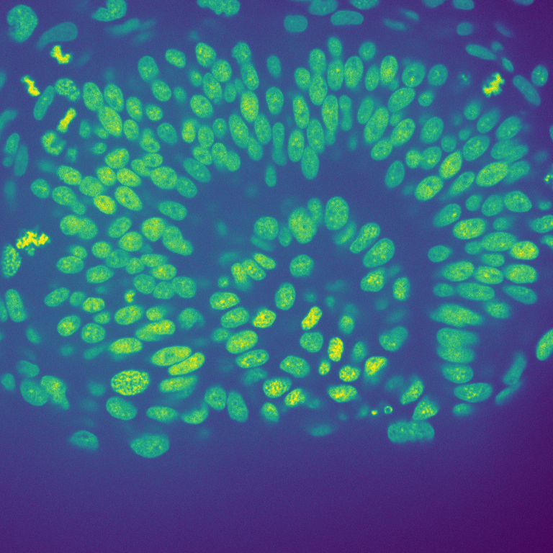

Evaluation metrics- segmentation PCC
GT
ZSSR
Pearson correlation between only the “significant” pixels
GT
PCC
ZSSR

Slide 14
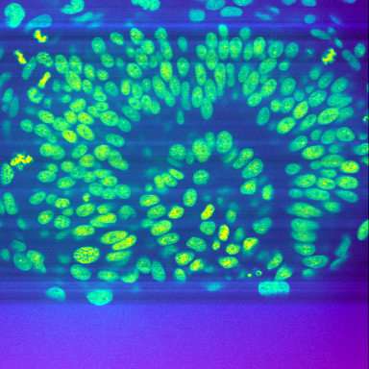
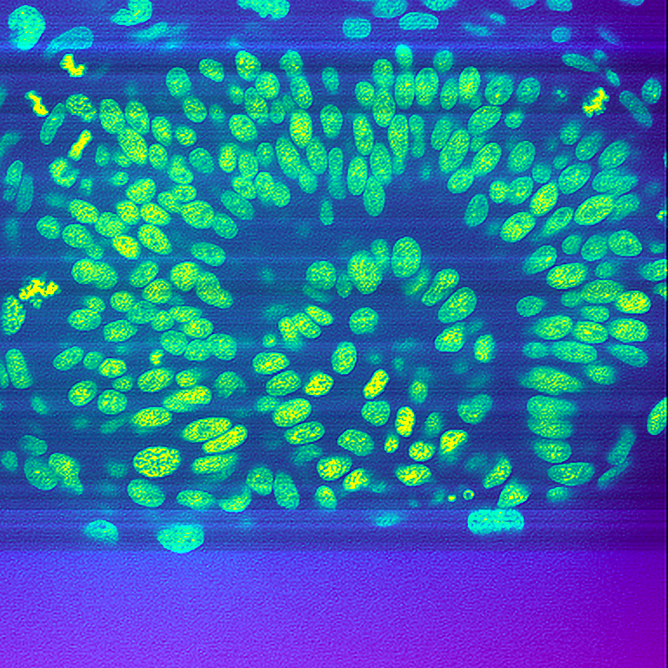
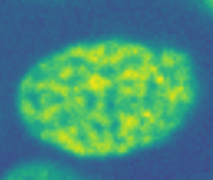
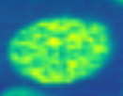
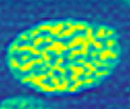
Results
Ground Truth
Downgraded
Prediction
SPCC=0.076
SPCC=0.108

Slide 15
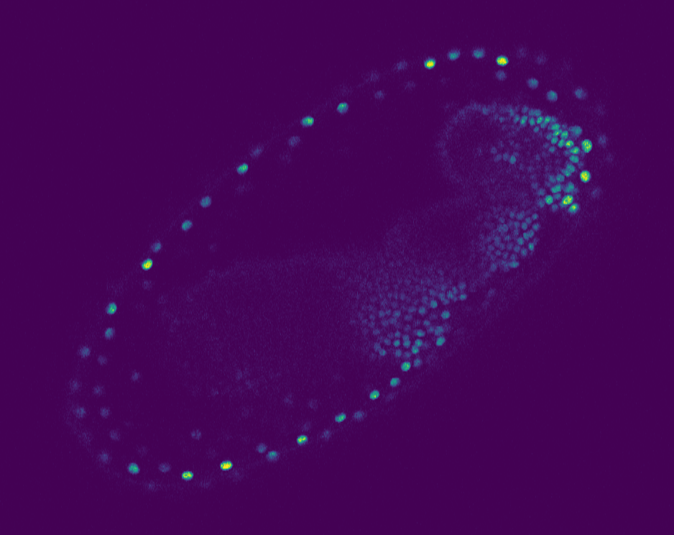
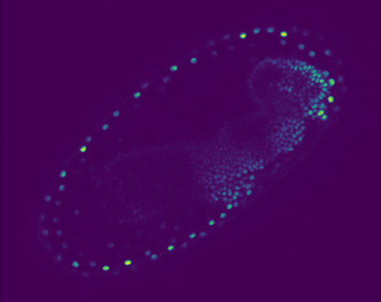
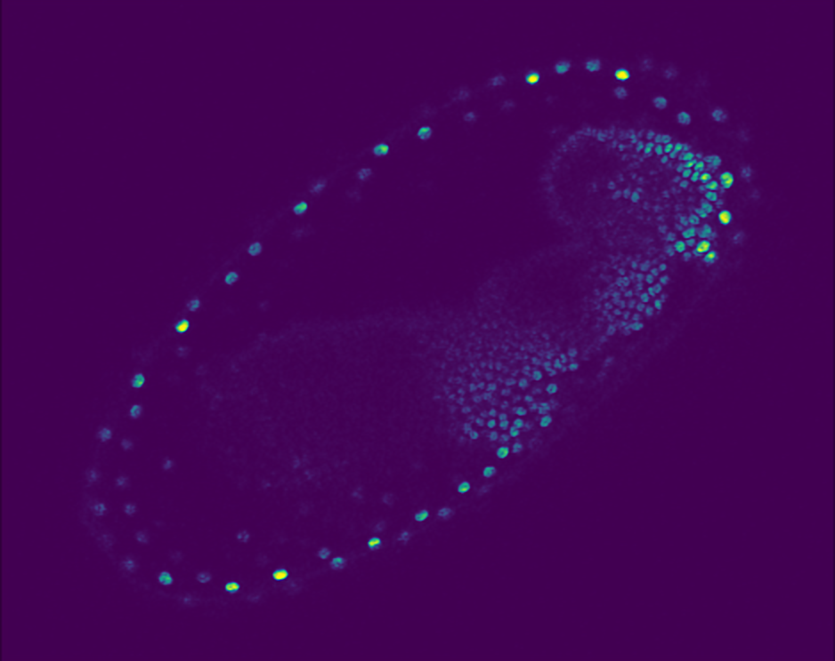
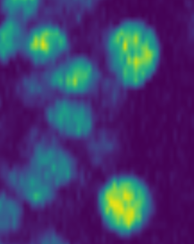
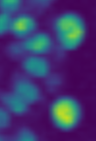
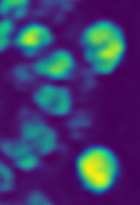
Results
Ground Truth
Downgraded
Prediction
SPCC= 0.057
SPCC= 0.15

Slide 16
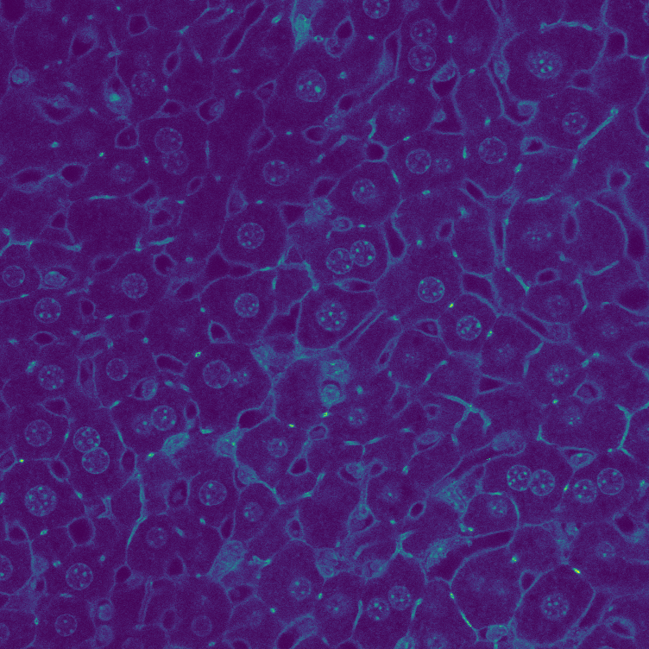
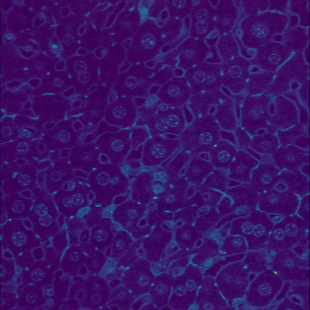
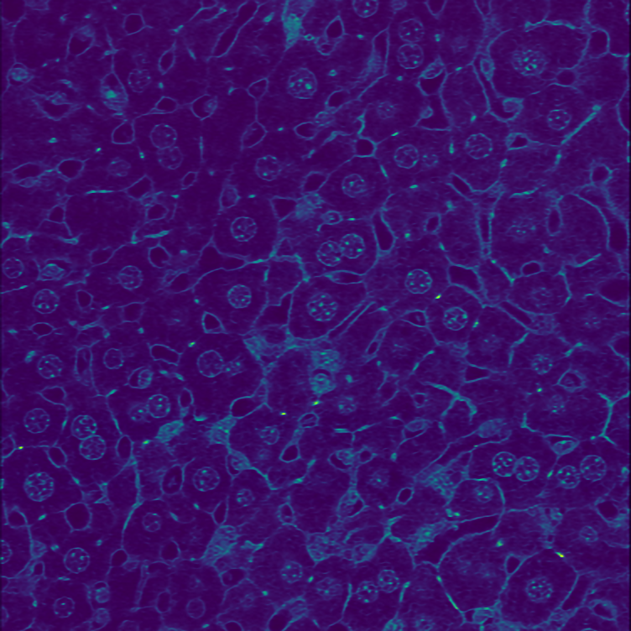
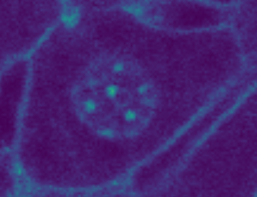
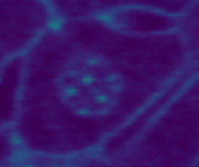
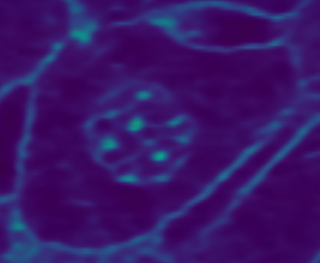
Results
Ground Truth
Downgraded
Prediction
SPCC= 0.097
SPCC= 0.112

Slide 17
Results- (placeholder)

Slide 18
Questions?

